Slide 1
Department of Information Engineering Academic Year 2022/2023
Database II
Game Of Thrones
Master’s Degree in Computer Engineering
Group Members :
Ebrahimi Mohammad Saeed
Kordi Mohsen
Mehrbanou Samane

Slide 2
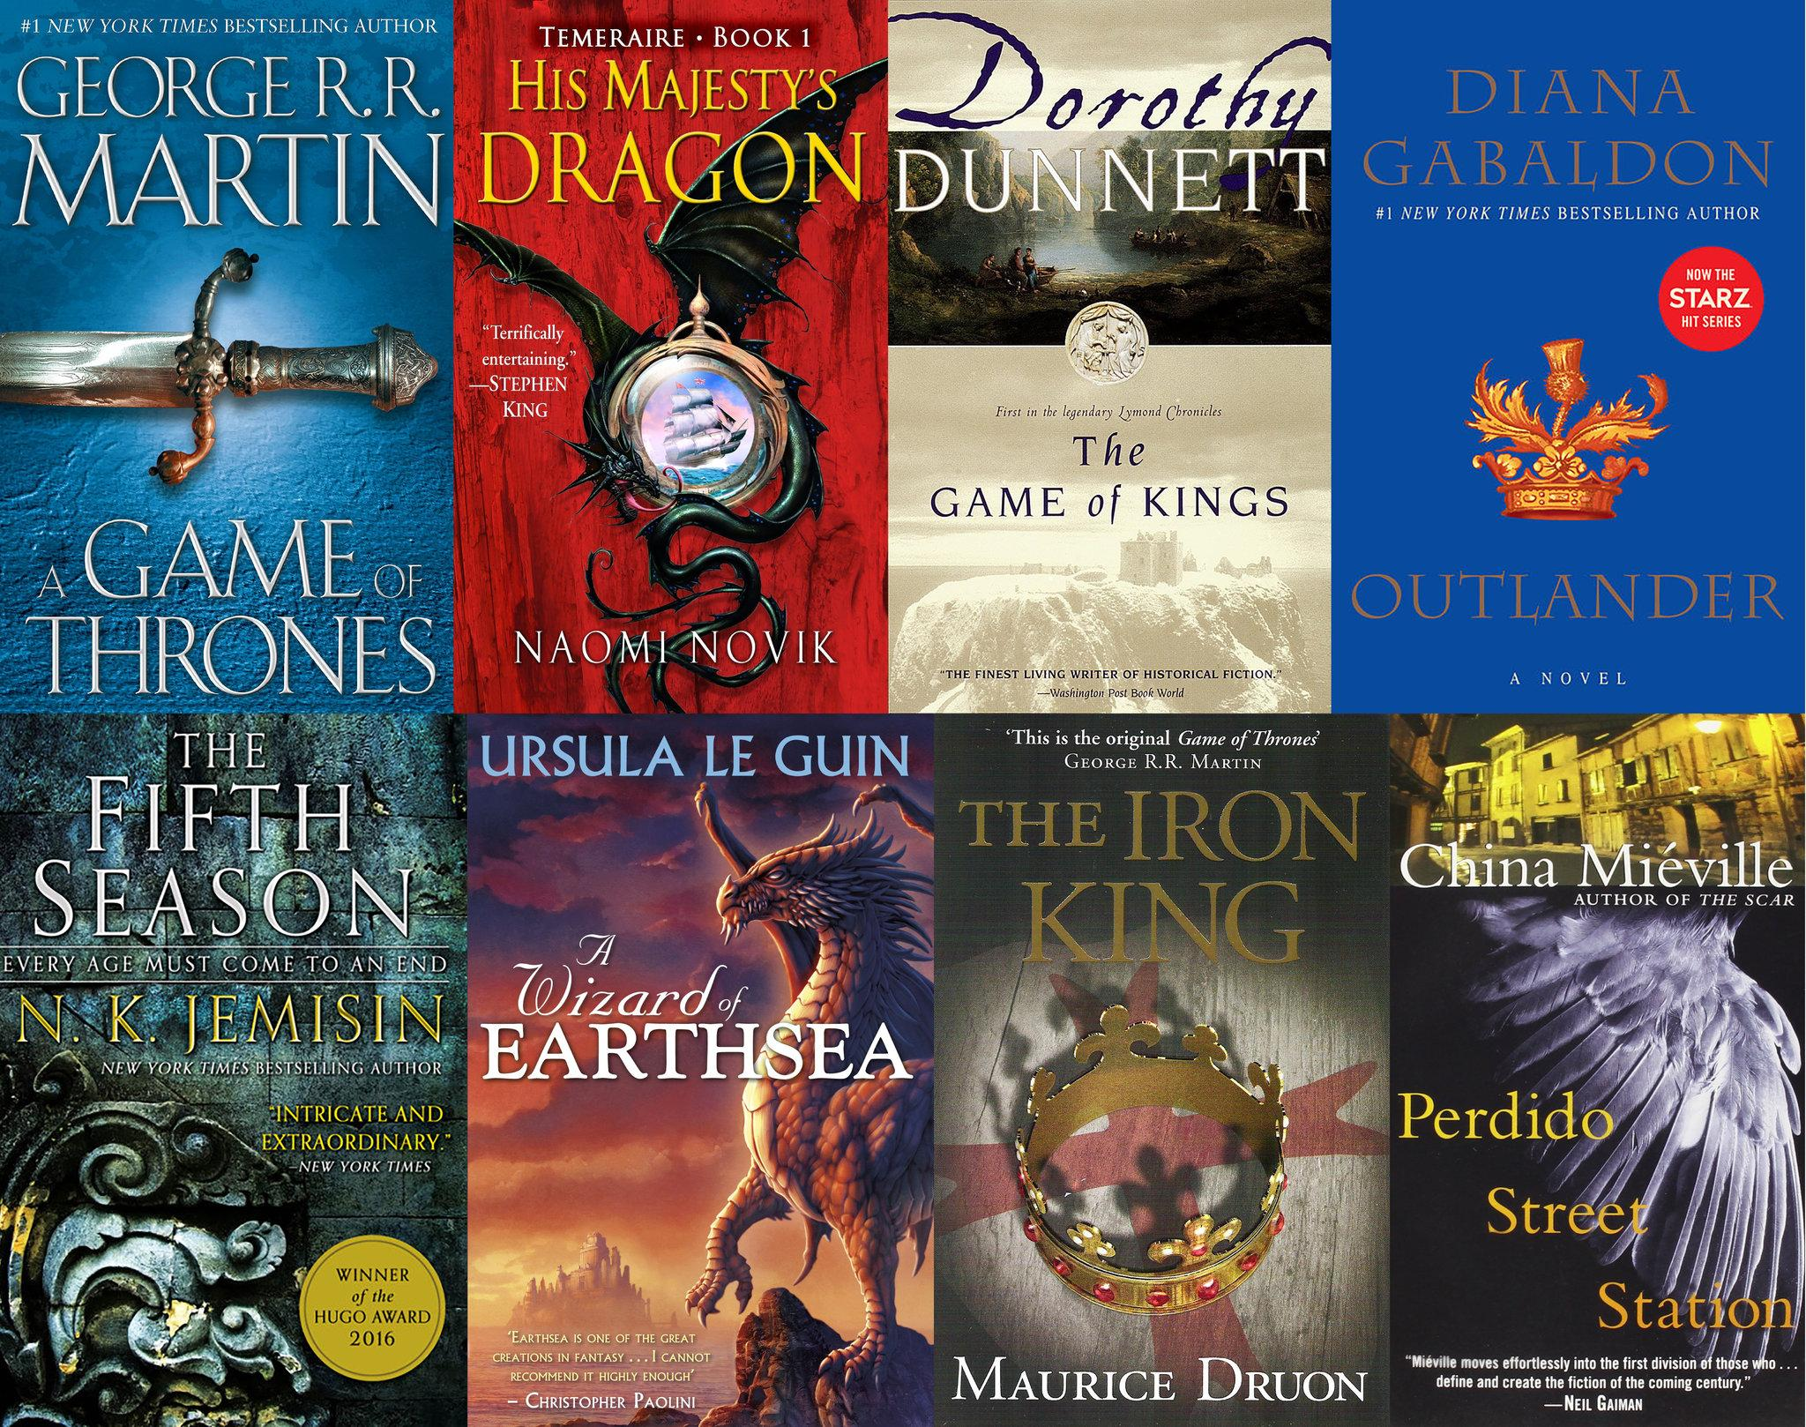
WHY GAME OF THRONES?

Slide 3
The Goal?
Our goal is to model characters of the book with their :
Relatives (Father, Mother, Spouse, Heir)
Properties (Culture, House, Age)
Popularity
Battles (Kings, Commanders, Houses of attacker/defender and battle year/result)

Slide 4
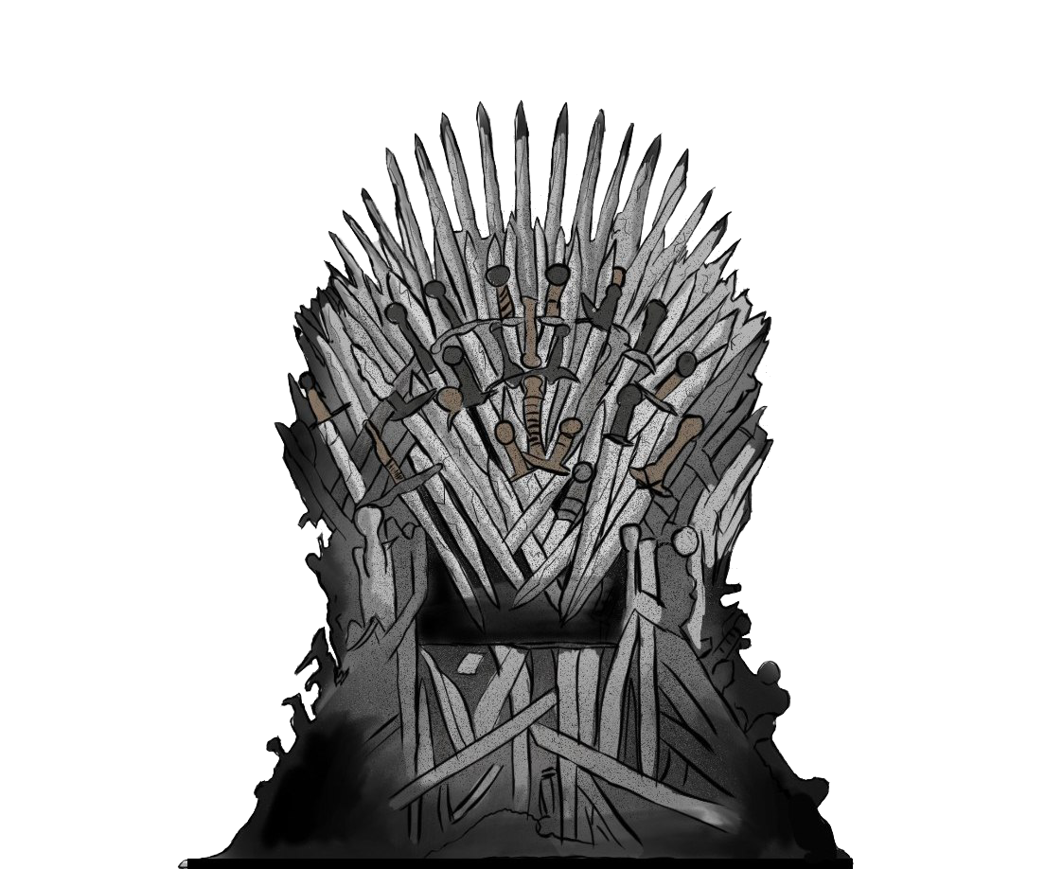
Which Datasets?
We Used 3 different Datasets related to the topic from kaggle.com and used them to complete and connect the data
1. First and Main dataset is: Game of Thrones - Classification (Decision) Tree
Which has a CSV file which contains the data about the characters
2. The second dataset is :463 Game of Thrones Houses Dataset
Which again has 1 CSV file with Houses details
3. The last dataset is: Game of Thrones
Which has 3 datasets one about the battles, one about the death of characters, and one
About the characters. From this dataset, we only used the battles CSV
We also find profiles of characters in Wikidata and link them.

Slide 5
Files and fields
The first file is : character_predictions_pose.csv Which has 30 columns. The most important fields are :
Name , title , house , father , mother , …. We decided not to use some columns like :
IsAlive , IsMarried ,etc, mostly because you could found the related data from the dataset or there was not any related data presented .
The second file is battles.csv
Which has 25 columns . and we used almost all of these columns .
The last file is Houses.csv . which has 9 columns and we used these ones :
Which has 9 columns, and we used 5 of them.
Region, house, sigil, blazon, origin

Slide 6
ONTOLOGY

Slide 7
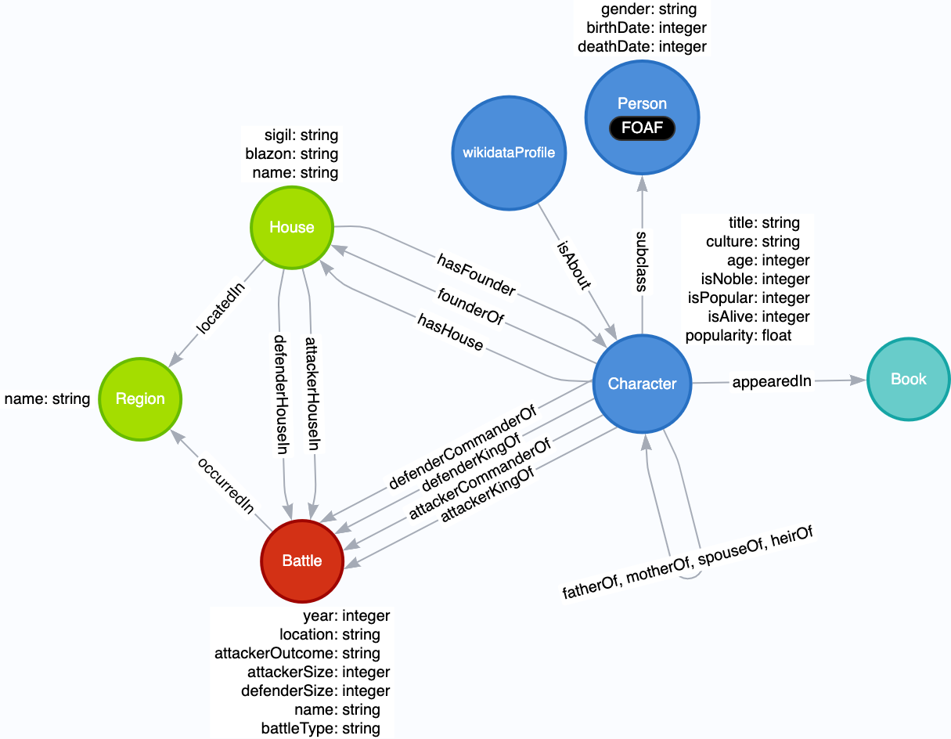
Graph Model

Slide 8
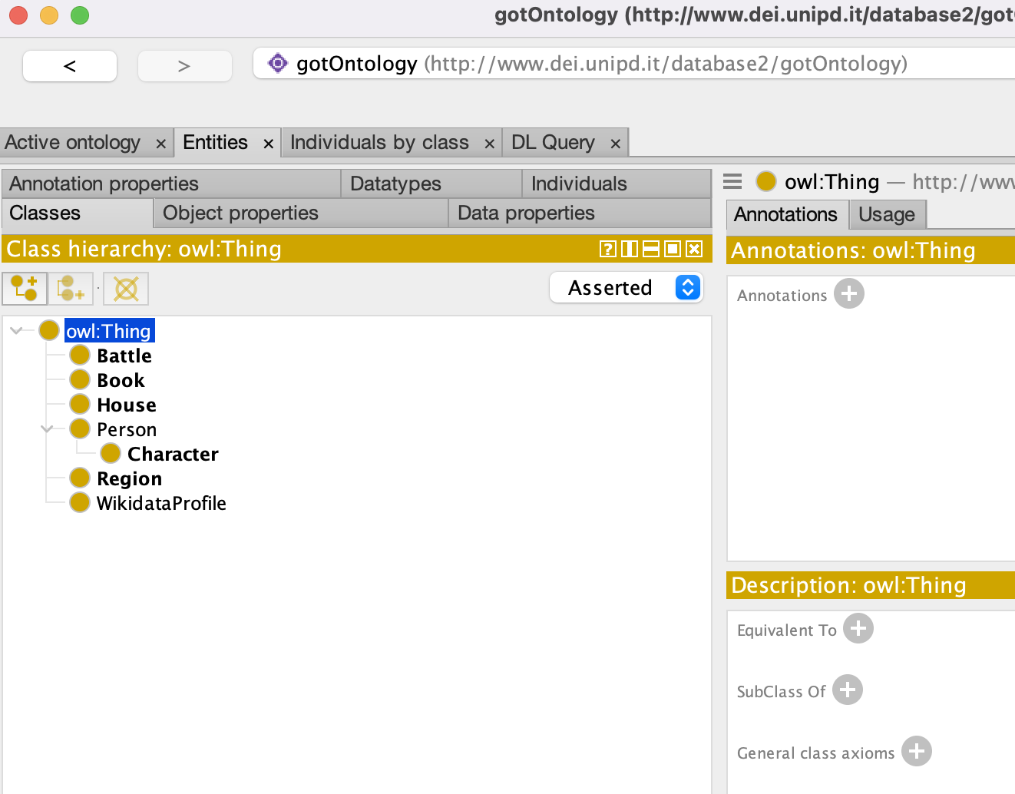
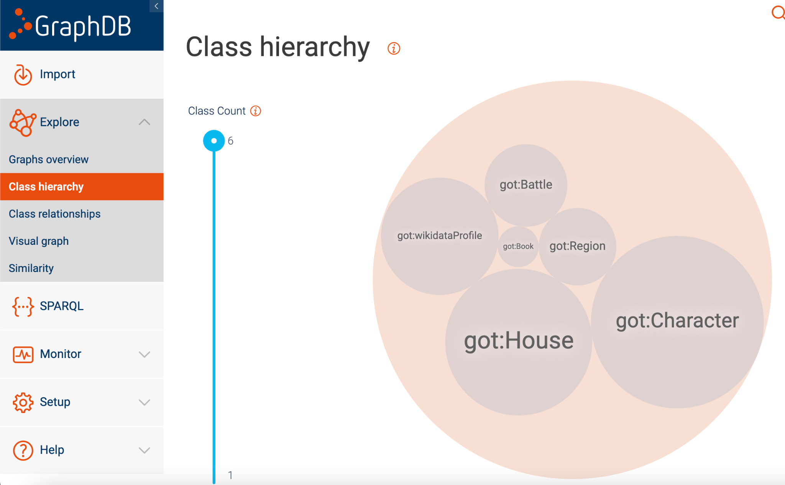
Implementation - Protege
Taxonomy

Slide 9
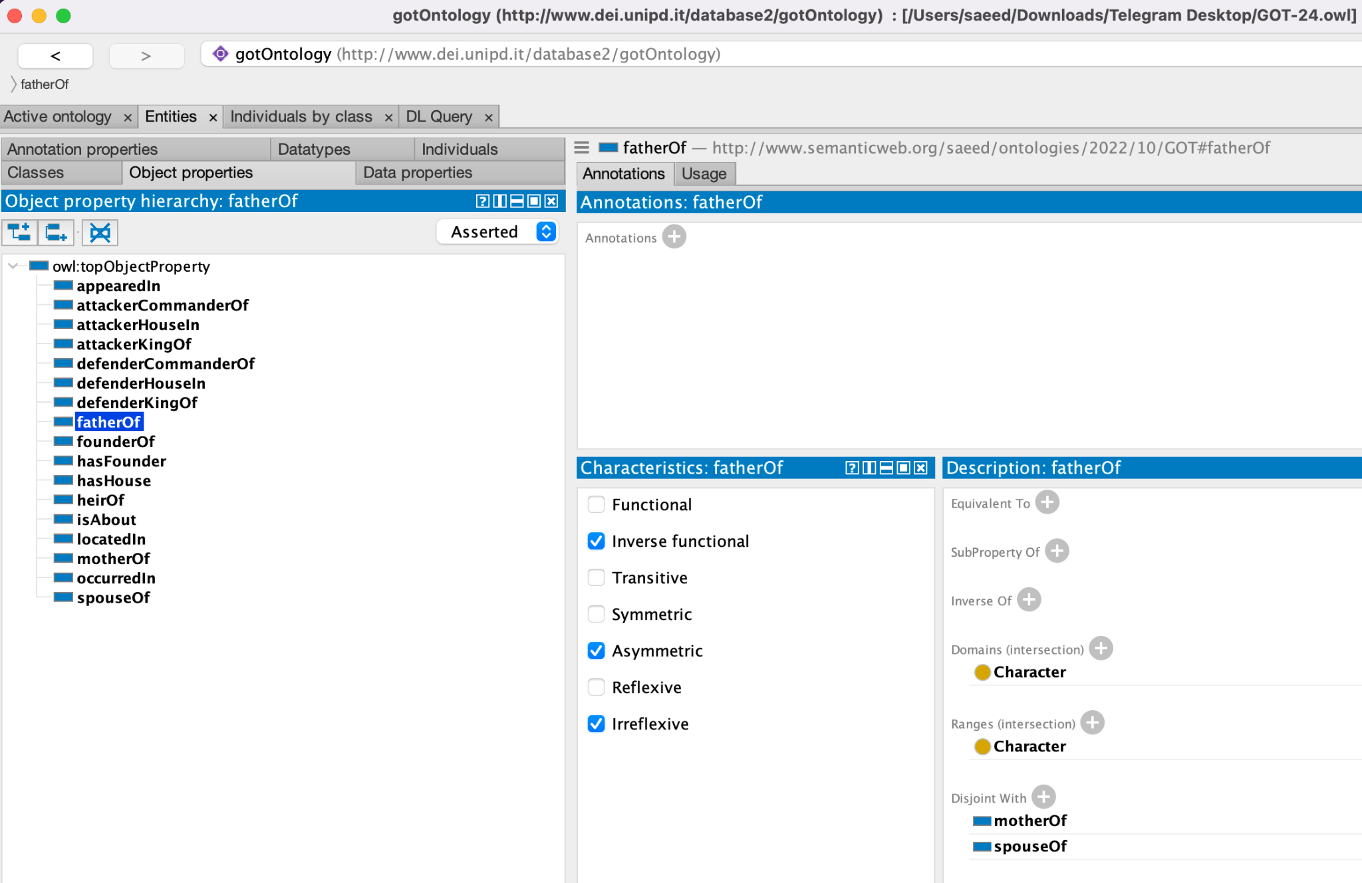
Implementation - Protege
2. Object Properties

Slide 10
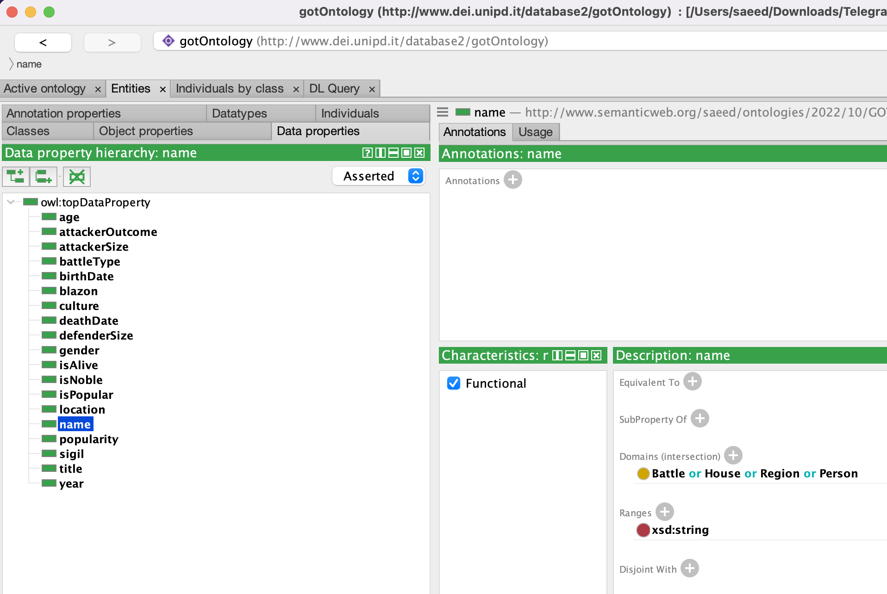
Implementation - Protege
3. Data Properties

Slide 11
Serialization
Loading
Pre-Processing
Cleaning
Post-Processing
Publishing
Load CSV Files
Replace Null values
Query Wikidata profiles
Drop useless columns
Rename columns based on ontology
Removing some part of data such as ‘House of’
Converting multivalued columns to multiple single valued columns
List all unique values of characters, regions, houses, cultures, battles
Add all unique values to graph
Add all properties to graph

Slide 12
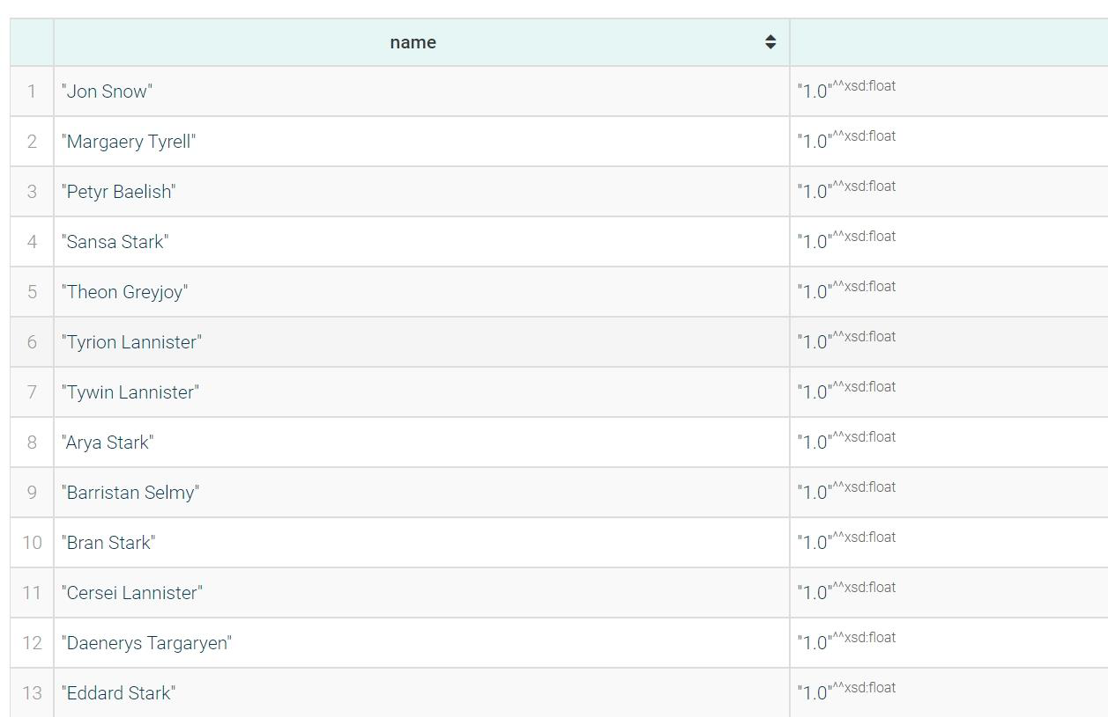
Sample Queries
Query Number 2: Average number of the army that attacker Houses used to invade
Query Number 5: 20 most popular people who were not involved in any battle
Query Number 8: 5 characters mostly won in battles as attacker king
Query Number 9: region names that had the highest number of win and loss battles
Query Number 10: all the battles that the attacker lost despite having more soldiers

Slide 13
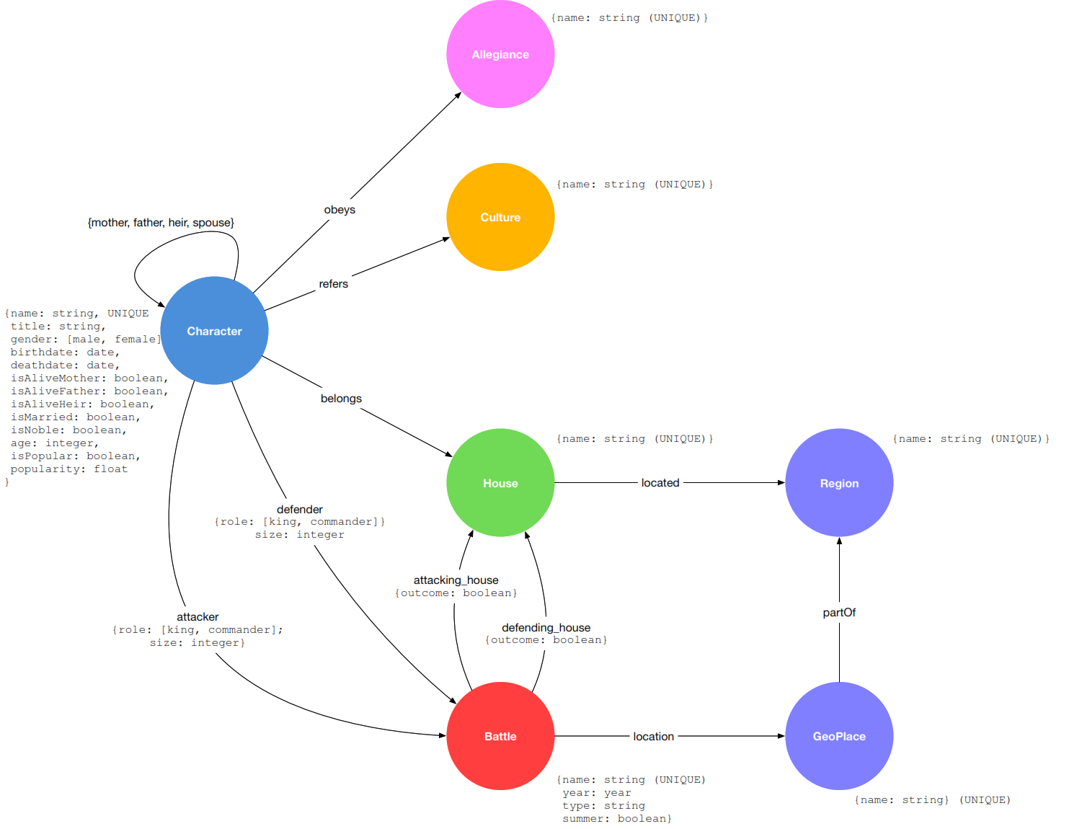
Comparison

Slide 14
Here is our repository link if you are interested in GoT and wanna try some queries
https://github.com/IamSaeedEbr/GOT

Slide 15
Thank you for your attention!

